Slide 1
Microprocessor
Chapter-3
Instruction Cycle

Slide 2
Introduction
Instruction or code is stored in memory.
For a instruction : MVI A, 44h
It has two part first is opcode and the second one is operand. Sometimes Instruction may contains two operands.
Instruction cycle:
Time required to execute and fetch one complete instruction is called instruction cycle.
It is the time require to complete the execution of an instruction.
It consists:
Fetch cycle – This the time required by μp to fetch the instruction from the memory to instruction register is called fetch cycle. The next instruction is fetched by the address stored in program counter (PC) and then stored in the instruction register.
Decode instruction – Decoder interprets the encoded instruction from instruction register
Reading effective address – The address given in instruction is read from main memory and required data is fetched. The effective address depends on direct addressing mode or indirect addressing mode.
Execution cycle – consists memory read (MR), memory write (MW), input output read (IOR) and input output write (IOW)

Slide 3
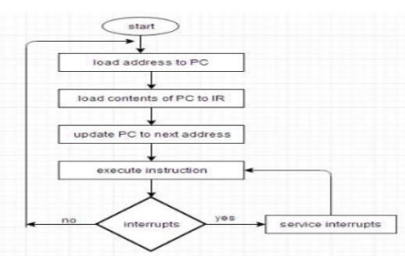
Introduction
Upon the completion of step 4, the control goes back to step 1 to fetch, decode, and execute the next instruction. This process continues indefinitely unless a HALT instruction is encountered.

Slide 4
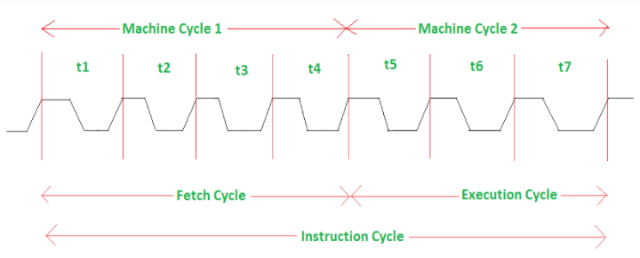
Introduction
T-state is defined as one subdivision of operation performed in one clock period. These subdivisions are internal states synchronized with the system clock, and each T-state is precisely equal to one clock period.
One time period of frequency of microprocessor is called t-state.
A t-state is measured from falling edge of one clock pulse of the falling edge of next clock pulse
Since 8085 works at 3MHz, one T-state = 1/3 microseconds=0.333 microseconds.

Slide 5
Introduction
Machine cycle
The time required for the microprocessor to access memory or an IO device either for a read operation or a write operation is called a machine cycle.
As the data bus of 8085 is 8-bit, one machine cycle will transfer one byte (8-bit). Instructions that require to read or write 16 bit data from memory, need multiple machine cycles.
An instruction cycle consists of various machine cycles.
The most important and compulsory machine cycle of every instruction is OPCODE FETCH . It is the first machine cycle of every instruction.
There are other machine cycles like memory read, memory write, I/O read, etc.
Machine cycles contain T-states.
Following are the different types of machine cycle:
Opcode fetch, which takes 4 to 6 t-states
Memory Read, which takes 3 t-states
Memory Write, which takes 3 t-states
I/O Read, which takes 3 t-states
I/O Write, which takes 3 t-states

Slide 6
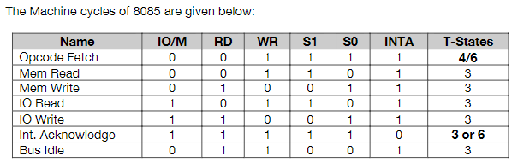
Introduction
Machine cycle

Slide 7
Operand fetch
This cycle is used to fetch the opcode from memory.
This the first machine cycle of every instruction.
It is a compulsory machine cycle.
It is generally of 4T states but some times instruction require a 6T state for opcode fetch.
During T1:
A15-A8 contains higher byte of adddress (PCH)
As ALE is high AD7-AD0 contains lower byte of address (PCL)
Since it is an opcode fetch cycle, S1 and S0 goes high.
Since it is memory read operation IO/M goes low.
During T2:
As ALE goes low, address is removed from AD7-AD0.
As RD goes low, data appears on AD7-AD0
As μp is reading data (opcode from memory), there is a propagation delay between sending the address and arrival of data. This is the time required for data to travel from memory to μp. Note: it is shown by dots between address and data.

Slide 8
Operand fetch
During T3:
Data remains on AD7-AD0 till RD is low. This the time given to μp to capture data (opcode) from the data bus into store it to instruction register.
During T4:
T4 state is used by the μp to decode the opcode.
This is how an opcode fetch cycle is different from memory read cycle.

Slide 9
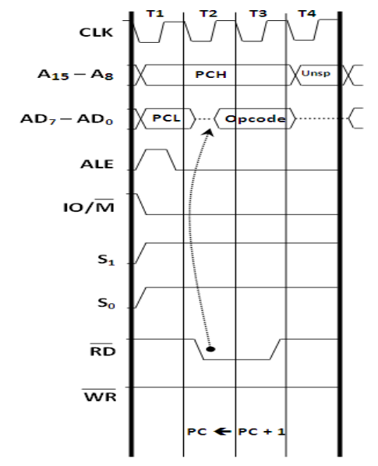
Operand fetch: Timing diagram
Timing diagram show what is happening in the buses. Decoding is an internal operation and hence is not shown in the timing diagram.

Slide 10
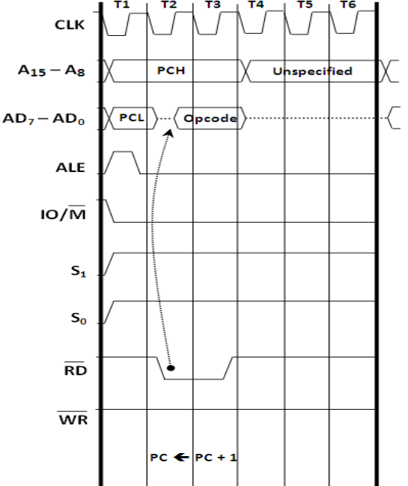
Opcode fetch: Timing diagram
Instructions that use a 6T Opcode Fetch are:
SPHL INX n PUSH CALL (all typos) __ RC (Conditional Rh RSTn
T5 and T6 are used for internal operation, so nothing happens in buses during that time, so nothing is shown in the timinig daigram

Slide 11
Memory Read
This cycle is used to fetch one byte from the memory to μp
This cycle can be used to fetch the operand bytes of an instruction or any data from the memory.
It is not compulsory machine cycle.
It requires 3T-states.
During T1:
A15-A8 contains the higher byte of address (PCH).
As ALE is high, AD7-AD0 contains the lower byte of the address (PCL).
In memory read cycle, S1 goes high and S0 remains low.
Similarly IO/M goes low.
During T2:
ALE goes low.
Address is removed from AD7-AD0.
As RD goes low, data appears on AD7-AD0.
During T3:
Data remains on AD7-AD0 as RD is low.

Slide 12
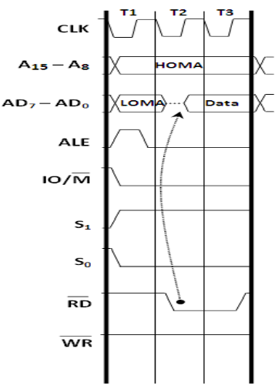
Memory Read
Note:
In read operation, there is propagation delay.

Slide 13
Memory Write
This cycle is used to send(write) one byte into the memory.
It is also not compulsory machine cycle.
It requires 3T-states.
During T1:
A15-A8 contains the higher byte of address (PCH).
As ALE is high, AD7-AD0 contains the lower byte of the address (PCL).
In memory write cycle, S0 goes high and S1 remains low.
Similarly IO/M goes low as it is memory operation.
During T2:
ALE goes low.
Address is removed from AD7-AD0.
Data appears on AD7-AD0 and WR goes low.
During T3:
Data remains on AD7-AD0 as WR is low.

Slide 14
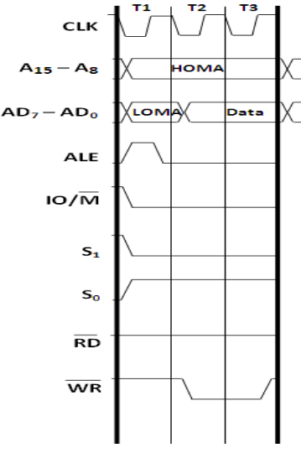
Memory Write
Note:
In write operation, there is no propagation delay.

Slide 15
IO Read
This cycle is used to fetch one byte from the IO port to μp
It is not compulsory machine cycle.
It requires 3T-states.
During T1:
The low 8-bits of IO port addresses are duplicated into higher order address bus A15-A8.
As ALE is high, AD7-AD0 contains the lower byte of the address (PCL).
In I/O read cycle, S1 goes high and S0 remains low.
Similarly IO/M goes high .
During T2:
ALE goes low.
Address is removed from AD7-AD0.
As RD goes low, data appears on AD7-AD0.
During T3:
Data remains on AD7-AD0 as RD is low.

Slide 16
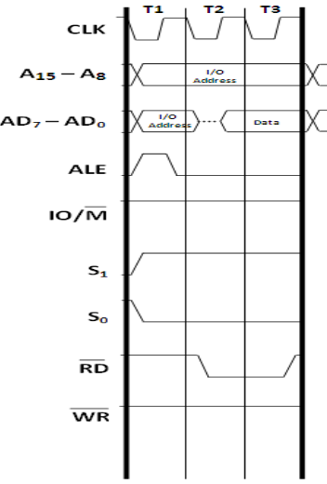
IO Read
Note:
In read operation, there is propagation delay.

Slide 17
IO Write
This cycle is used to send(write) one byte into the IO port from μp.
It is also not compulsory machine cycle.
It requires 3T-states.
During T1:
The low 8-bits of IO port addresses are duplicated into higher order address bus A15-A8.
As ALE is high, AD7-AD0 contains the lower byte of the address (PCL).
In I/O write cycle, S0 goes high and S0 remains high.
Similarly IO/M goes high .
During T2:
ALE goes low.
Address is removed from AD7-AD0.
Data appears on AD7-AD0 and WR goes low.
During T3:
Data remains on AD7-AD0 as RD is low.

Slide 18
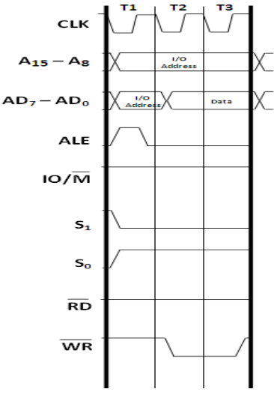
IO Write
Note:
In write operation, there is no propagation delay.

Slide 19
Memory Interfacing
Interface is the path for communication between two components. There are two type of interfacing: memory interfacing and I/O interfacing.
The program an data that are executed by microprocessor have been stored in ROM/EPROM and RAM, which are basically semiconductor memory chips.
Microprocessors need to access memory quite frequently to read instruction and data stored in memory.
For this, both memory and microprocessor requires some signals to read from and write to registers.
For this, interface include some key factors to match with memory requirement and processor signals i.e. interface circuit enables memory access to read or to write.
Memory has certain signal requirement to read from and write into memory. Similarly, microprocessor initiates the set of signals when it wants to read from and write into memory.
8085 has 16 address lines, so it can have maximum 65536 memory location for interfacing.
Memory address space range from 0000H to FFFFH.
The 8085 microprocessor initiates IO/M’, RD’, WR’ while it wants to read or write from or to the memory
Each memory chip has signals like CS or CE (Chip Select or Chip Enable), OE or RD’ (output enable or read) and WE or WR’ (write enable or write)

Slide 20
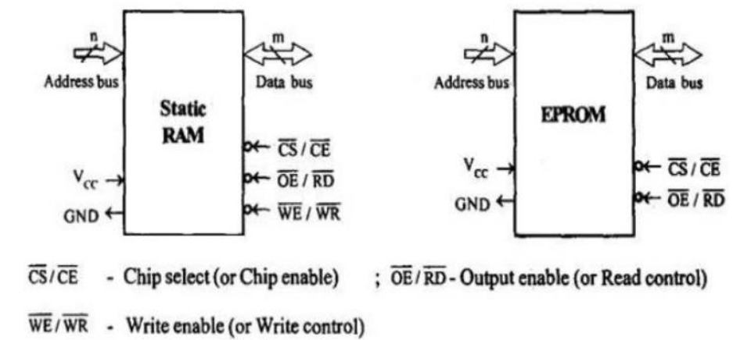
Memory Interfacing

Slide 21
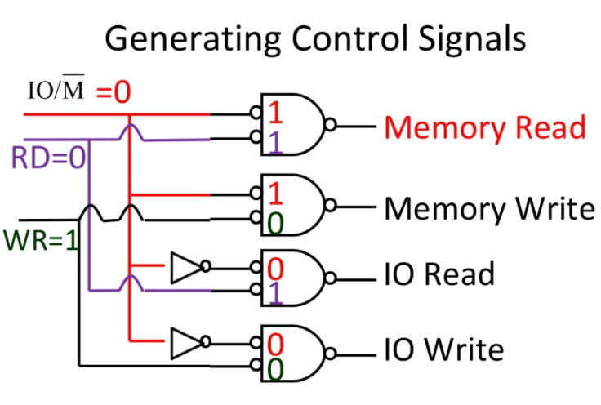
Memory Interfacing
Generation of Control Signals for Memory
IO/M’, RD’, WR’ signals two control signals memory read and memory write are generated.

Slide 22
Memory Interfacing
Generation of Control Signals for Memory
8085 place 16 bit address on address bus then only 11 low order address lines are jused.
Remaining 5 higher order address lines should be decoded to generate chip select.
So, the primary function of memory interfacing is that microprocessor must be able to read from and write into a given register of a memory chip.
- Select the chip
- Identify the register
- Enable appropirate buffer.

Slide 23
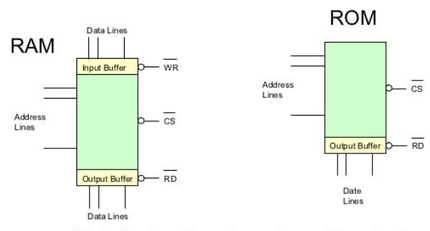
Memory Interfacing
Structure of R/W memory i.e. RAM
- 2048 registers
- Each can store 8 bit of data
- So, it has 8 input lines and 8 output lines.
- 11 address lines (AD10-AD0), 1 chip select, 2 control lines to enable input and output buffer.
- Internal decoder to decode address lines.
Structure of ROM (EPROM)
- 4096 registers
- Each can store 8 bit of data
- It has only 8 output lines.
- 12 address lines (A11-A0), 1 chip select, 1 Read control lines to enable output buffer.
- Internal decoder to decode address line.

Slide 24
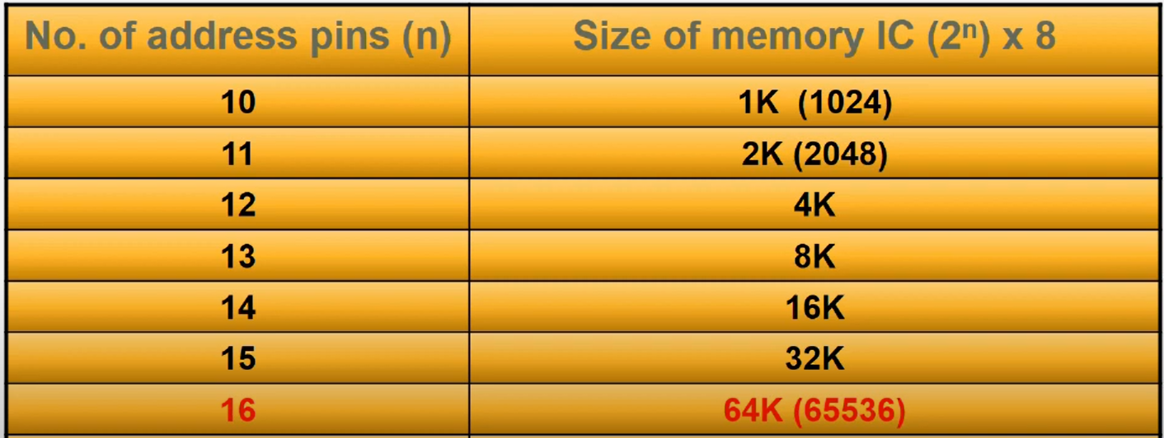
Memory Interfacing
For example:
Interface 4KB memory to 8085 with starting address A000H
4KB memory requires 12 address lines for addressing and 4 address lines are used for address decoding.
The address range of memory becomes: A000H to AFFFFH
Here, A0-A11 address lines are directly connected to address bus of memory chip.
A12-A15 are used for generating chip select signal for memory chip.

Slide 25
Memory Interfacing
For example:
Interface 4KB memory to 8085 with starting address A000H
4KB memory requires 12 address lines for addressing and 4 address lines are used for address decoding.
The address range of memory becomes: A000H to AFFFFH
Here, A0-A11 address lines are directly connected to address bus of memory chip.
A12-A15 are used for generating chip select signal for memory chip.

Slide 26
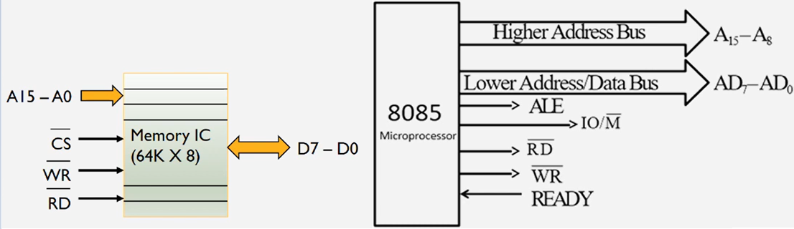
Typical memory IC requires
Address bus depending on the size of memory to be interfaced.
The control signals needed for static RAM are chip select (chip enable or CS’)
Read control (output enable or RD’) and write control (write enable or WR’)
The control signals needed for read operation in EPROM are chip select and read control as we don’t write in read only memory.

Slide 27
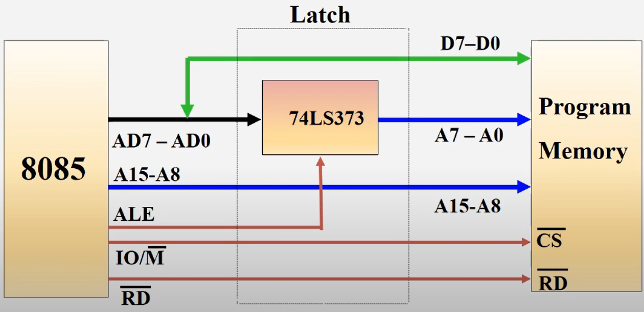
8085 Interfacing with memory Chips

Slide 28
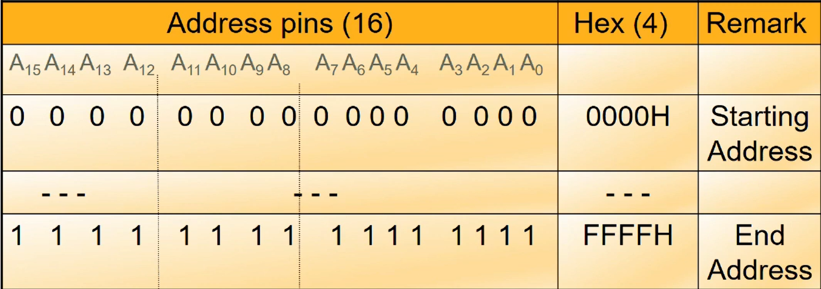
Address Decoding table

Slide 29
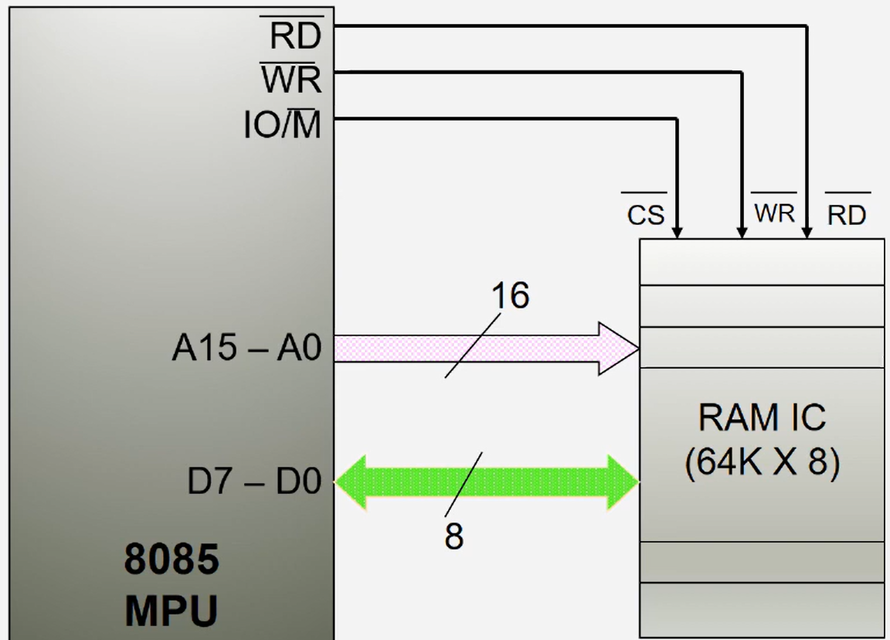
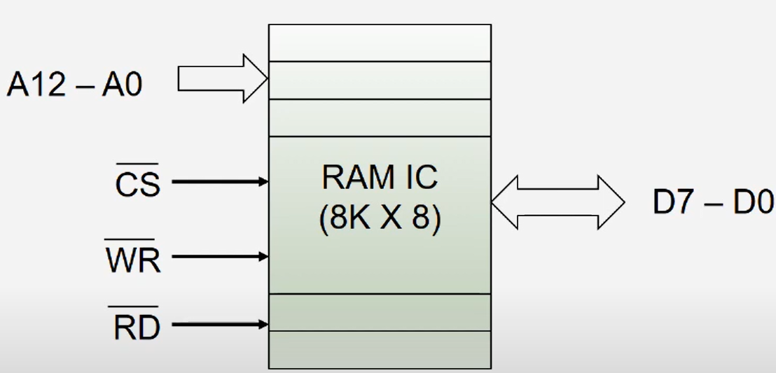
Interfacing of 64K and 8K RAM with 8085
For 64K RAM there is 16 address lines where as in 8K RAM there is 13 address line from (A12-A0)
Both has 8 data lines i.e. (D7-D0).

Slide 30
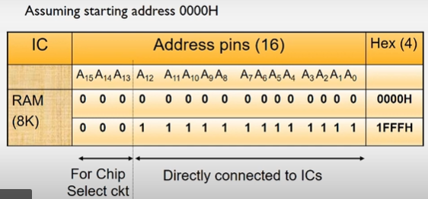
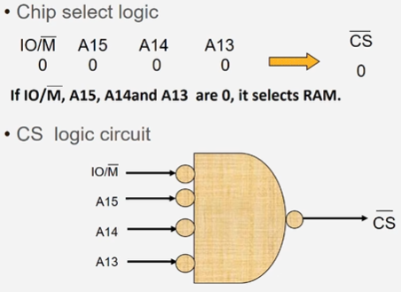
Address Decoding table Chip select design using Logic gates for 8K RAM

Slide 31
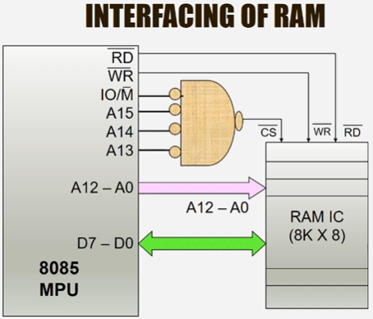
Address Decoding table Chip select design using Logic gates for 8K RAM

Slide 32
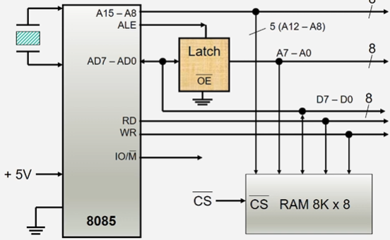
Typical memory interfacing

Slide 33
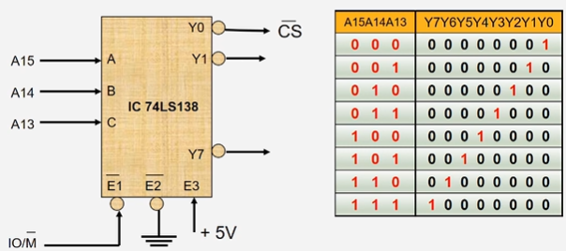
Chip select Circuit using Decoder IC 74LS138
Chip select (CS) or slave select (SS) is the name of a control line in digital electronics used to select one (or a set) of integrated circuits (commonly called "chips") out of several connected to the same computer bus, usually utilizing the three-state logic.

Slide 34
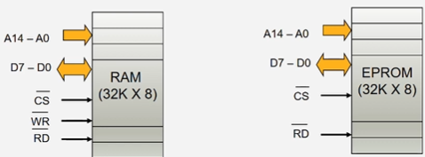
Example:
Consider a system in which the available 64kb memory space is equally divided between EPROM and RAM. Interface the EPROM and RAM with 8085 processor.
Implement 32Kb memory capacity of EPROM using single IC 27256
Assume starting address for ROM as 0000H
Address line required for 32 Kb=15 i.e. 2¹⁵

Slide 35
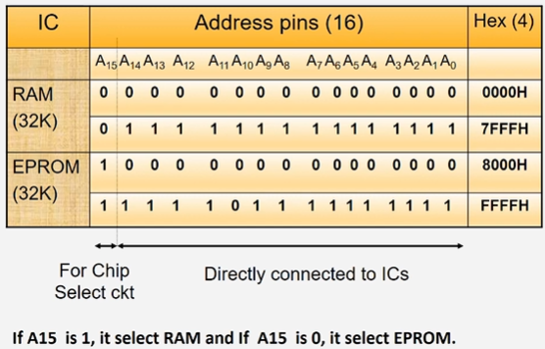
Example:
Consider a system in which the available 64kb memory space is equally divided between EPROM and RAM. Interface the EPROM and RAM with 8085 processor.

Slide 36
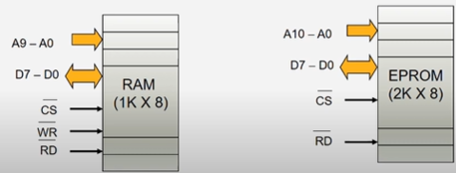
Interfacing 2KB of EPROM and 1KB of RAM with 8085:
Assume starting address for EPROM as 0000H
RAM will be after EPROM
Number of address lines for RAM is 10 which are from A9-A0.
Number of address line for EPROM is 11 which are from A10-A0.
Number of data line is 8 i.e. D7-D0

Slide 37
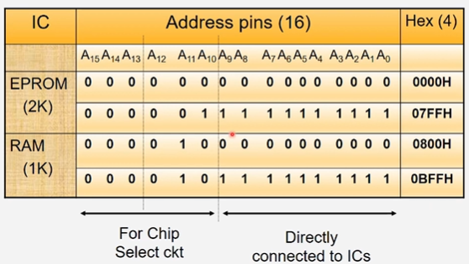
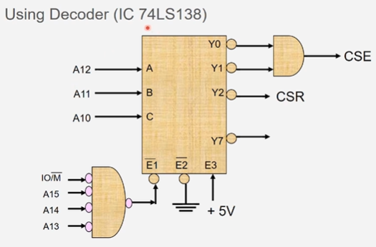
Address Decoding table for above memory interface

Slide 38
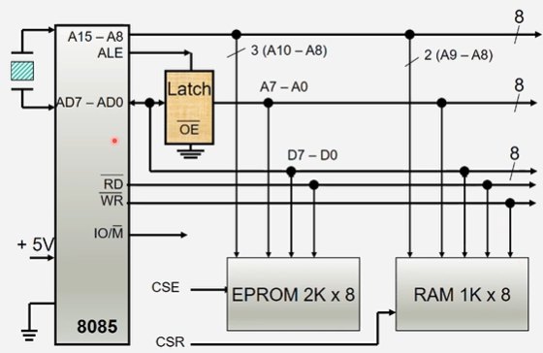
Memory Interfacing for EPROM 2K and RAM 1K

Slide 39
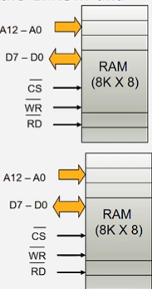
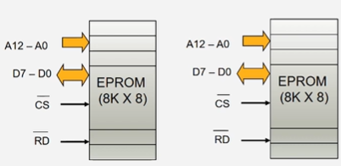
Example:
Consider a system in which 32kb memory space is implemented using four numbers of 8Kb memory. Interface the EPROM and RAM with 8085 processor.

Slide 40
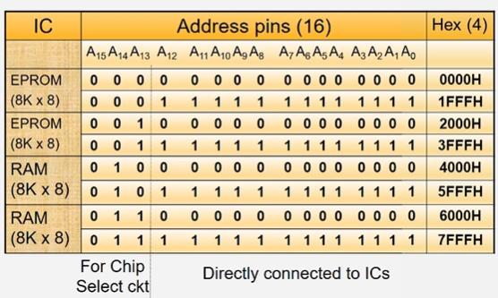
Example:
Consider a system in which 32kb memory space is implemented using four numbers of 8Kb memory. Interface the EPROM and RAM with 8085 processor.
Address decoding table

Slide 41
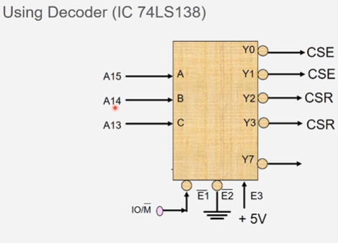
Example:
Consider a system in which 32kb memory space is implemented using four numbers of 8Kb memory. Interface the EPROM and RAM with 8085 processor.
Chip Select Circuit

Slide 42
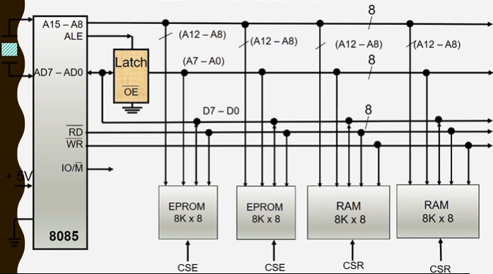
Example:
Consider a system in which 32kb memory space is implemented using four numbers of 8Kb memory. Interface the EPROM and RAM with 8085 processor.
Typical memory interfacing

